Slide 1
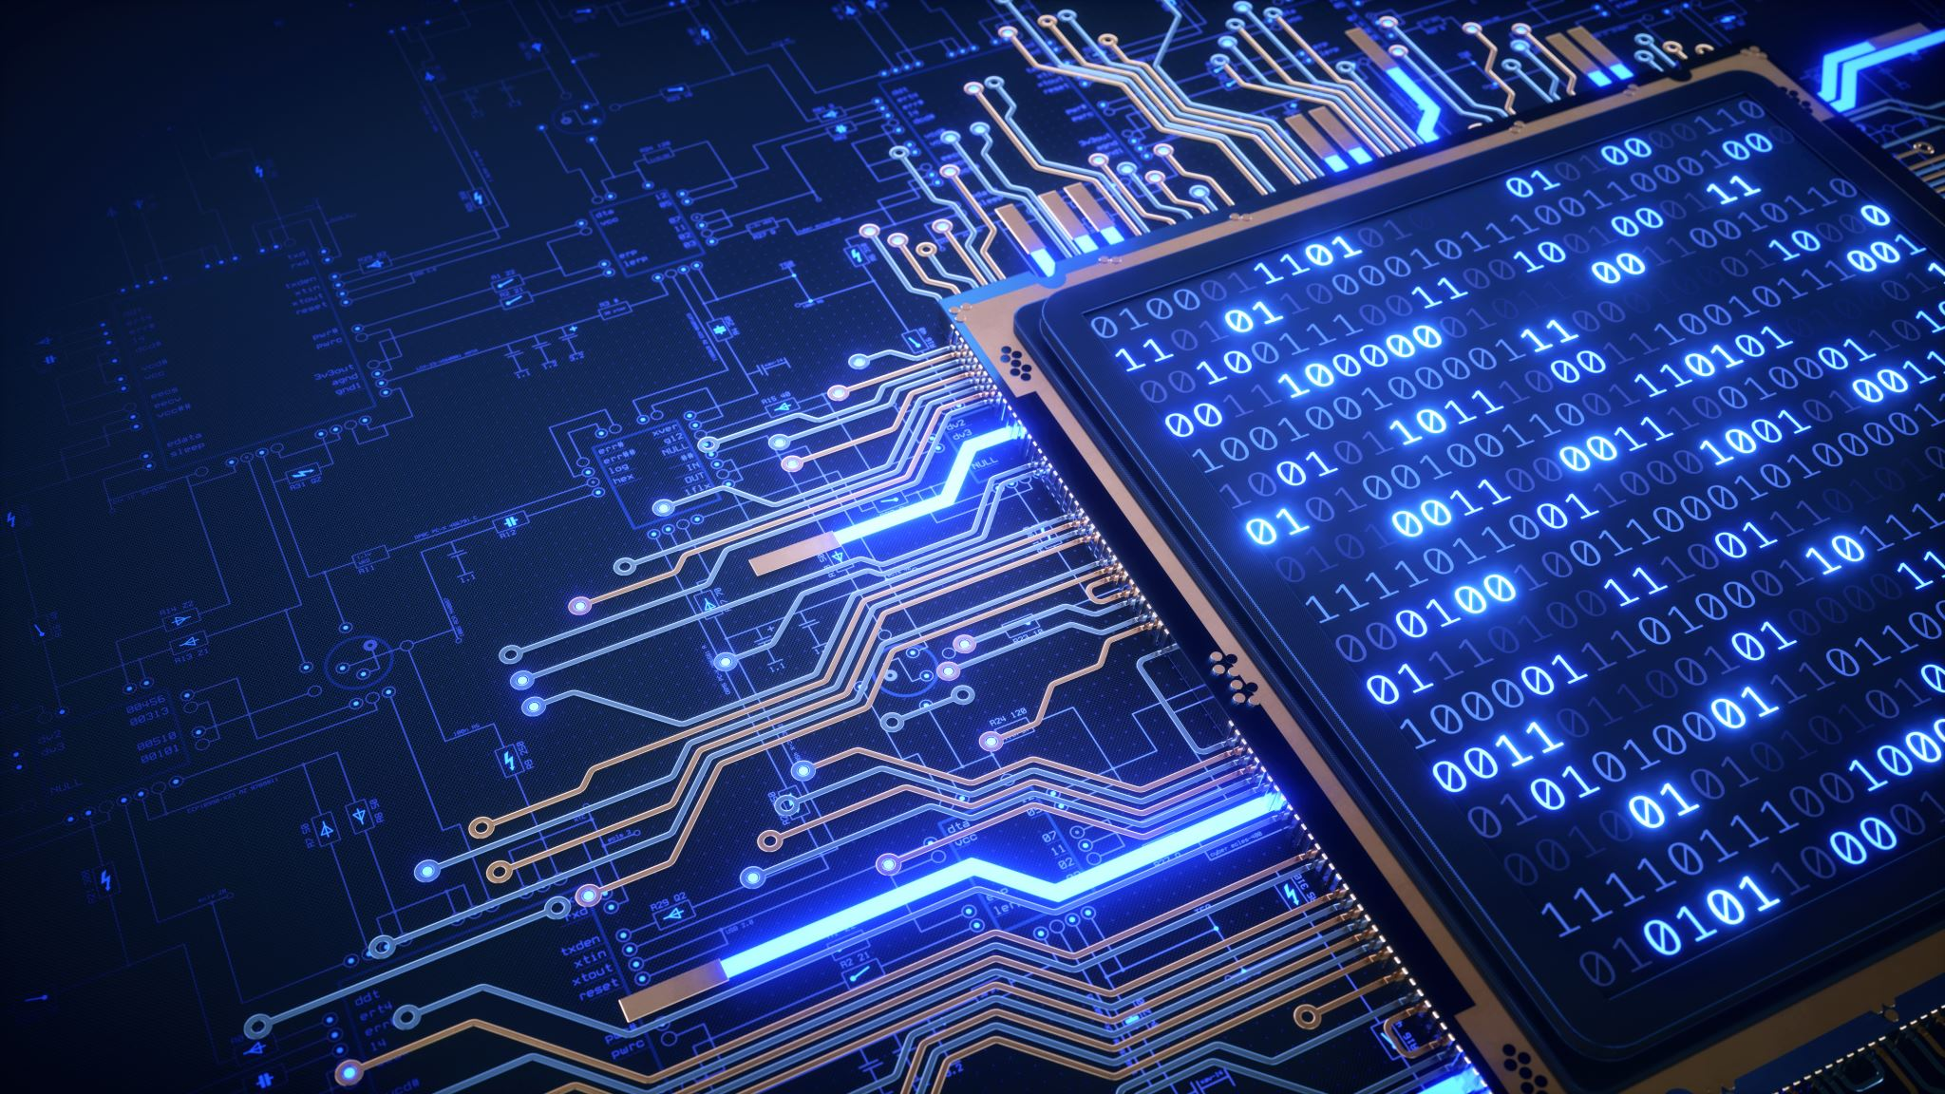
EVOLUTION OF ENGINEERING
name – Sneha Gupta
Reg. no – ra2511003010163
Year/semester – first
Branch/section – btech cse core/ c1
Academic year – 2025-2026 odd semester

Slide 2


Prehistory

Slide 3
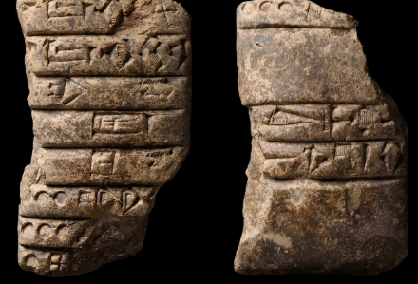
Prehistory
EARLY TOOLS-
Counting stones, tally marks, notched bones.
Clay tablets for trade & farming records.
Purpose: survival, basic arithmetic.

Slide 4


Medieval

Slide 5
Medieval
ALGORITHMS AND PHILOSOPHY-
Al-Khwarizmi → algebra & algorithms.
Fibonacci → number sequences in Europe.
Manuscripts preserved mathematical logic.

Slide 6

Present

Slide 7
Present
ELECTRONIC AGE-
Microprocessors, supercomputers, GPUs.
Everyday use: smartphones, cloud, IoT.
Philosophy: speed, efficiency, global access.

Slide 8
Present
Artificial Intelligence → automation, decision-making.
Quantum computing → solving complex problems.
Philosophy: ethics, sustainability, responsibility.

Slide 9

Comparison

Slide 10
Comparison
ERA | METHODS | PURPOSE | PHILOSOPHY
PREHISTORY | Tally,Abacus | Survival,Trade | Count to survive
MEDIEVAL | Clocks,Algorithm | Power,Religion | Calculate to dominate
PRESENT | Computers,AI | All human activity | Computation=civilization

Slide 11


Conclusion

Slide 12
Conclusion
Evolution = from survival → power → global intelligence.
Computation isn’t just a tool anymore — it defines modern life.
Future: AI & quantum → ethics + responsibility.(Visual: future tech glowing.)

